Slide 1
CHB-MIT
Feature Representation and Dimensionality Reduction

Slide 2
Seizures
198 clinical seizures annotated by experts
However, in one case (chb 12), some seizure recordings were changed from bipolar to unipolar montage (these are excluded – 13 in total)
Channel consistency across all recordings is ensured; this means only 18 channels are used
3 seizure files (for now at least) were excluded to make a 4-sec segment 60 sec after annotated seizure ending
Right now, this yields 182 interictal and 182 ictal segments
Notes:
to ensu

Slide 3
Feature Representation
”A High-Performance Seizure Detection Algorithm based on Discrete Wavelet Transform (DWT) and EEG” – Chen et al., 2017
159 citations and ”Scopus” peer-reviewed
The paper investigates the six frequency sub-bands for EEG with different wavelet families and selects different statistical features of the sub-bands for machine learning
ML model is a binary SVM classfier and evaluation was done with “leave-one-out” cross-validation and evaluation metrics used were primarily accuracy, sensitivity and specificity
According to Chen et al., the result was best when using the wavelet family (Coiflets; coif3), and seven statistical features (Max, Min, Mean, STD, Skewness, Energy and Normalized STD).
Accuracy: 92.30%, Sensitivity: 91.71%, Specificity: 92.89%
Notes:
person/one person

Slide 4
Feature Representation
182 ictal segments of 4 seconds selected at the middle of annotated seizure start and end
182 interictal segments of 4 seconds selected 60 seconds after annotated seizure end
Segments are DWT decomposed according to the results of Chen et al. and the seven statistical features are extracted yielding the following data shape for one segment: [1, 18, 42] corresponding to [segment, channels, features]

Slide 5
t-SNE: t-Distributed Stochastic Neighbor Embedding
t-SNE is an unsupervised, non-linear technique used for data exploration and visualizing high-dimensional data
In contrast to Principal Component Analysis (PCA) which was developed in 1933, t-SNE was developed in 2008 by Van Der Maaten and Hinton
PCA seeks to maximize variance and preserve large pairwise distances and t-SNE differs by preserving only small pairwise distances or local similarities.
t-SNE calculates a similarity measure between pairs in both the high dimensional space and the low dimensional space. It then tries to optimize these two similarity measures using a cost function
Notes:
PCA seeks to maximize variance and preserve large pairwise distances: In other words, things that are different end up far apart, which can lead to poor visualization especially when dealing with non-linear manifold structures.

Slide 6
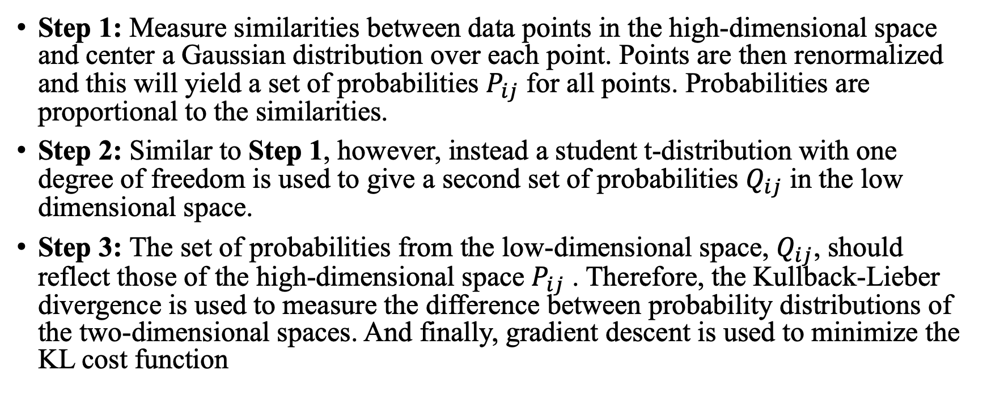
t-SNE: How The Algorithm Works
Step 1: Measure similarities between data points in the high-dimensional space and center a Gaussian distribution over each point. Points are then renormalized and this will yield a set of probabilities $P_{ij}$ for all points. Probabilities are proportional to the similarities.
Step 2: Similar to Step 1, however, instead a student t-distribution with one degree of freedom is used to give a second set of probabilities $Q_{ij}$ in the low dimensional space.
Step 3: The set of probabilities from the low-dimensional space, $Q_{ij}$, should reflect those of the high-dimensional space $P_{ij}$ . Therefore, the Kullback-Lieber divergence is used to measure the difference between probability distributions of the two-dimensional spaces. And finally, gradient descent is used to minimize the KL cost function
Notes:
All that means is, if data points x1 and x2 have equal values under this gaussian circle then their proportions and similarities are equal and hence you have local similarities in the structure of this high-dimensional space. The Gaussian distribution or circle can be manipulated using what’s called perplexity, which influences the variance of the distribution (circle size) and essentially the number of nearest neighbors. Normal range for perplexity is between 5 and 50 [2].

Slide 7
t-SNE: Hyperparameters
Perplexity: Influences the variance of the Gaussian distribution and essentially the number of nearest neighbors (according to Van Der Maaten and Hinton, normal range for perplexity is between 5 and 50)
Iterations: Number of iterations needed for tSNE to converge; the more iterations the better, however, typically not feasible to have 10.000 for big data
Number of Components: Just like PCA, you would like to have a few amounts of components to explain most of the data and to visualize the data in 2D or 3D.

Slide 8
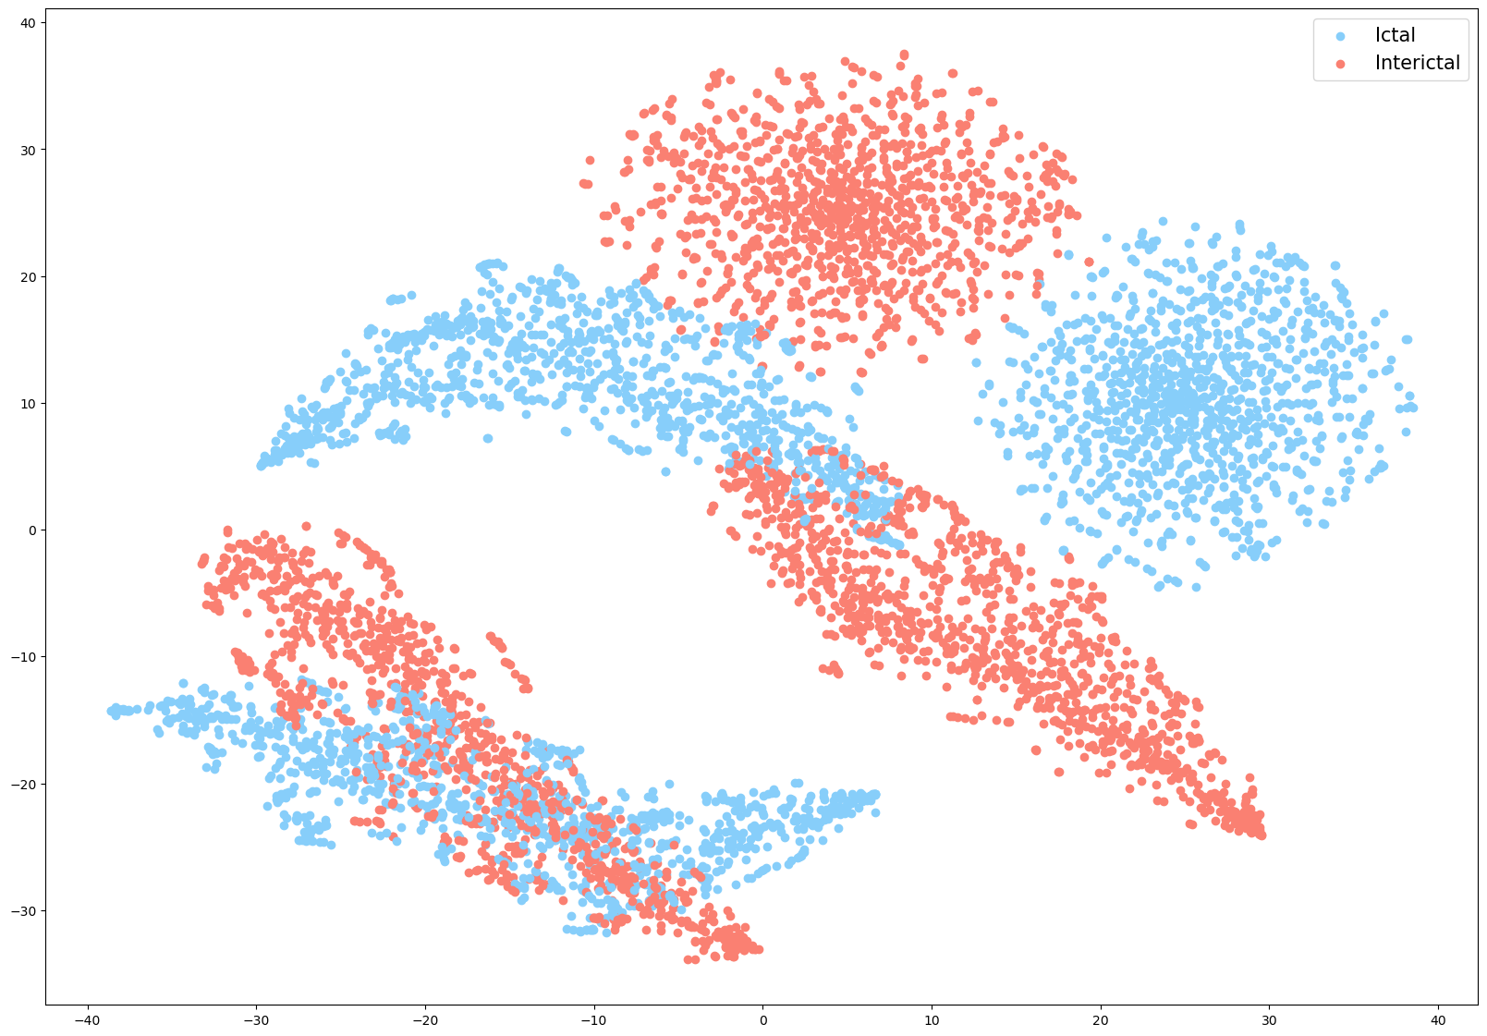
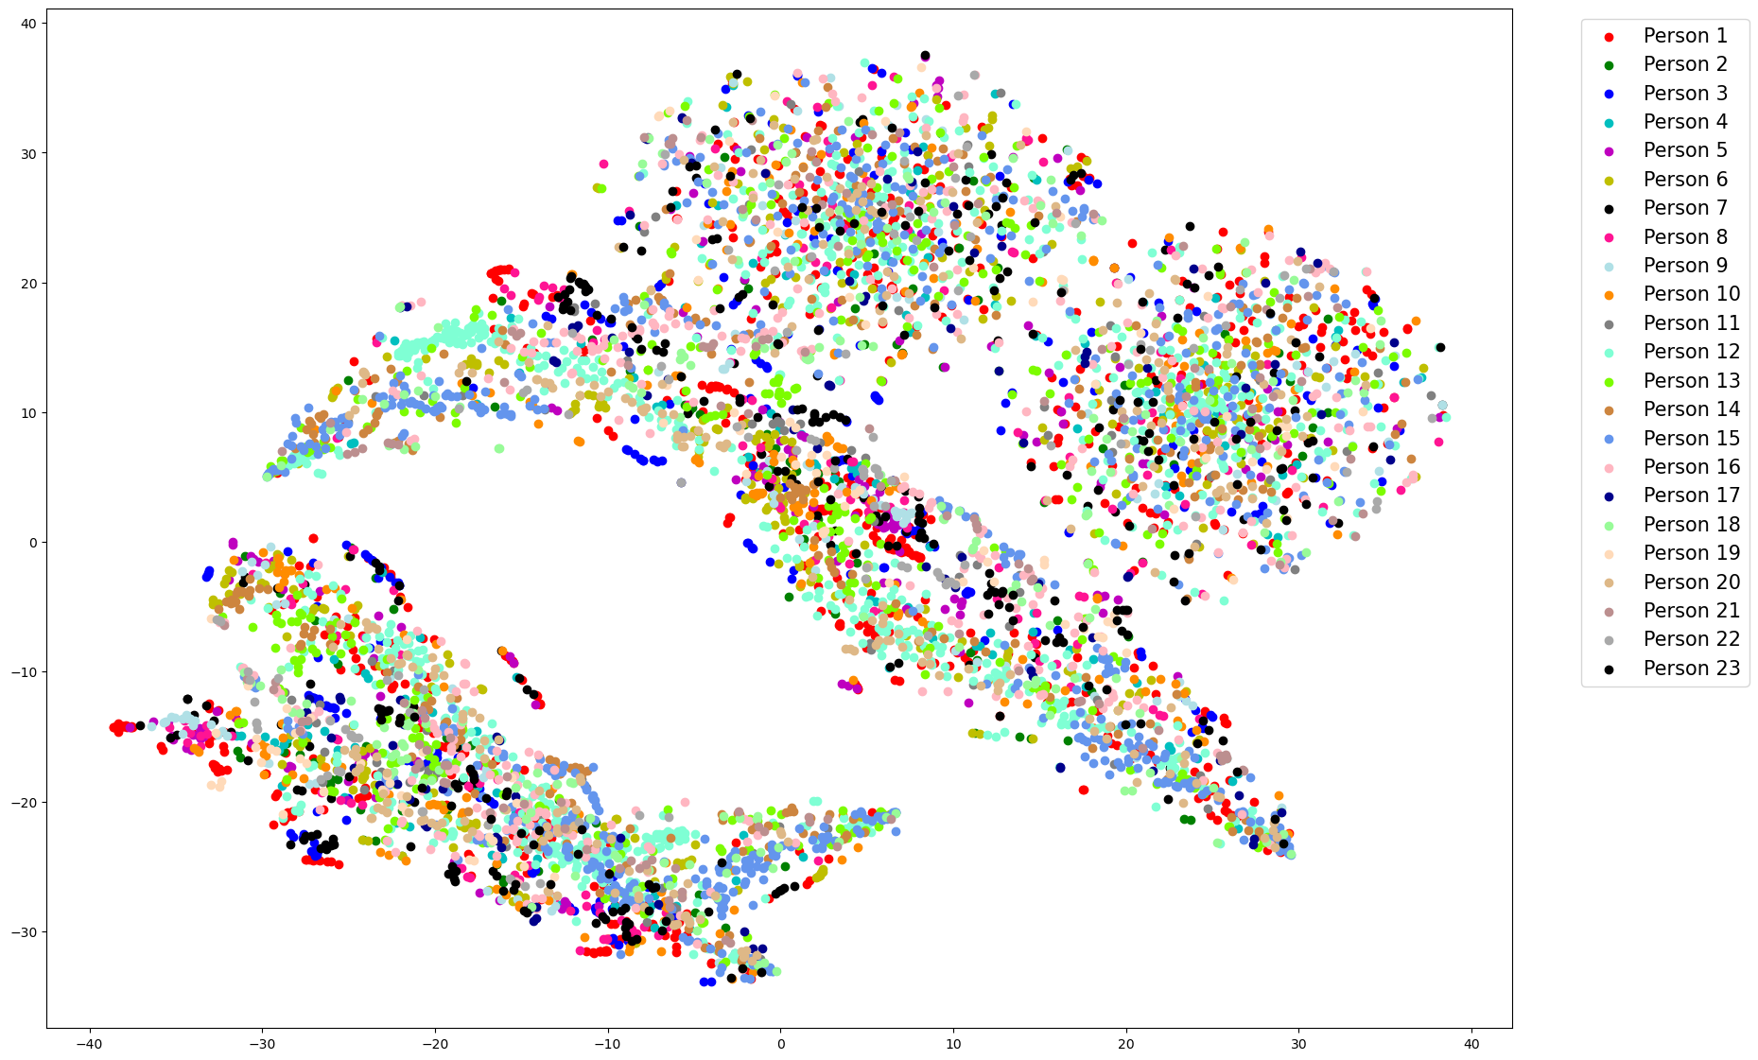
t-SNE: Results
Perplexity: 50, Iterations: 8
Labeled by ictal and inter-ictal state
Labeled by patients

Slide 9
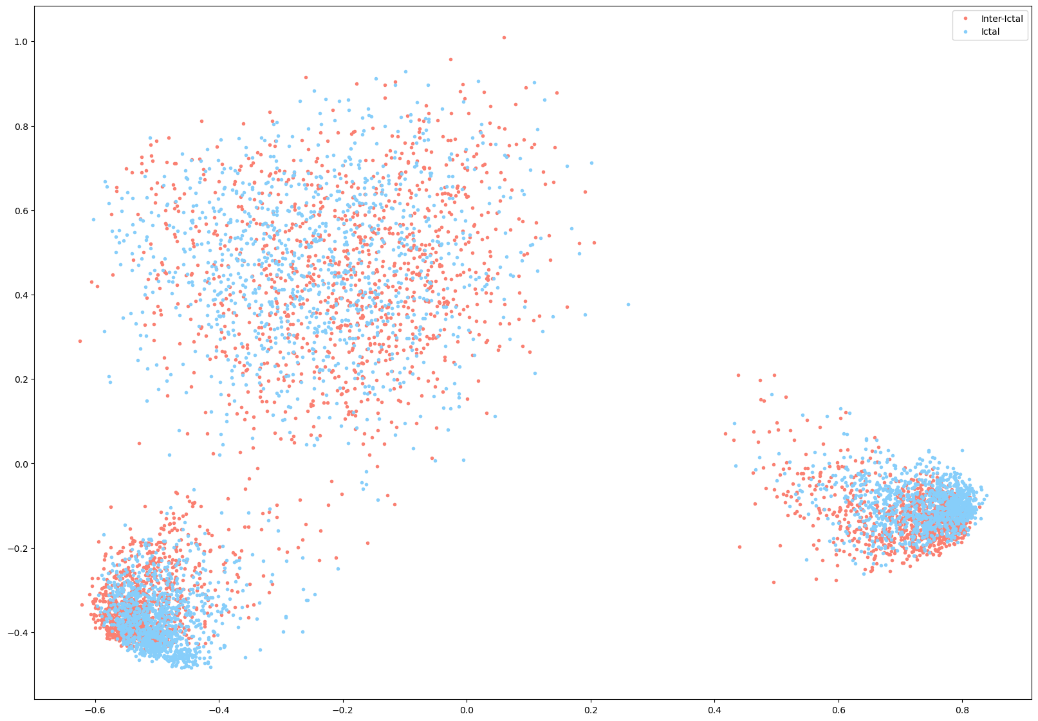
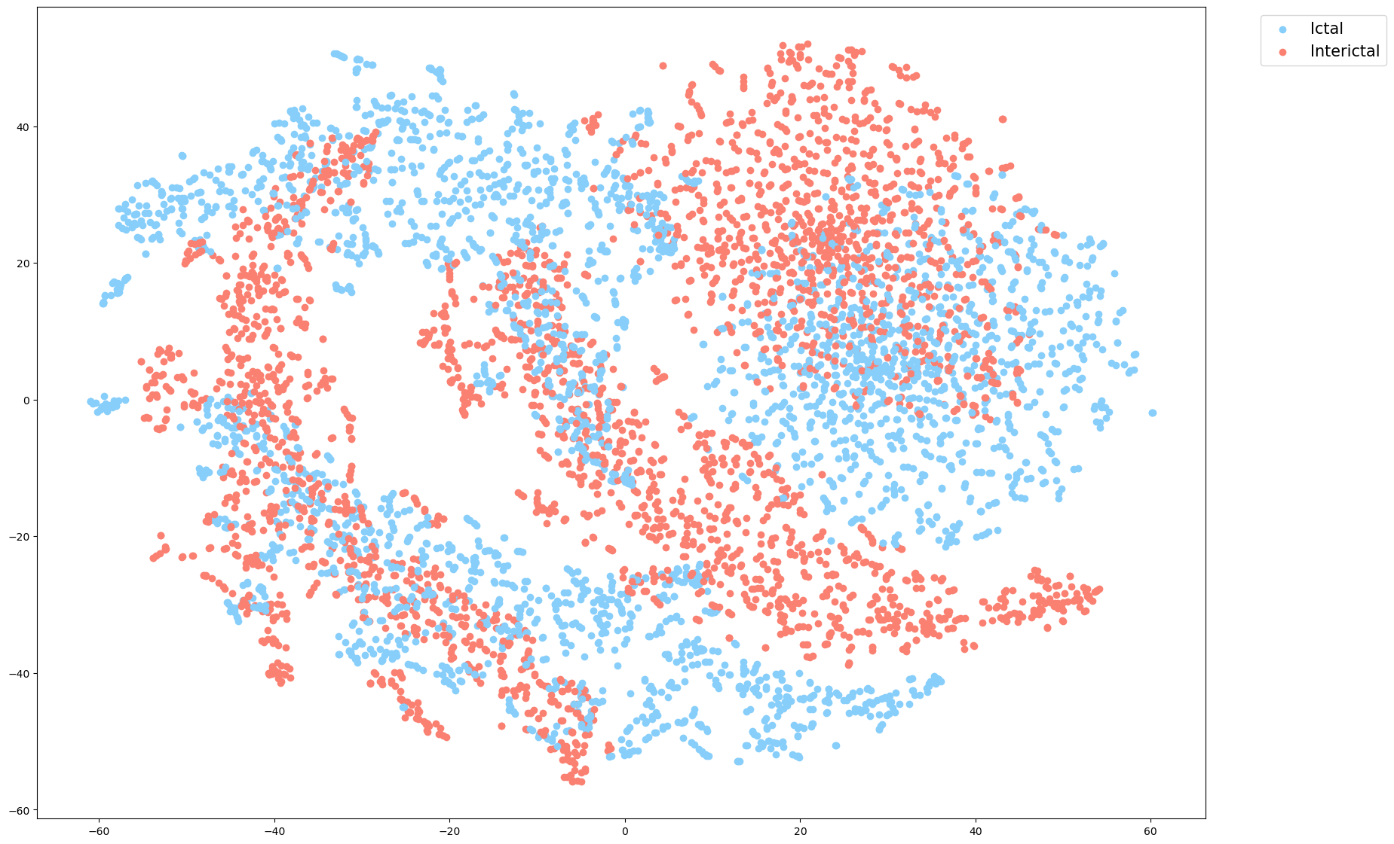
… and PCA + lower perplexities
t-SNE
Perplexity: 15, Iterations: 8
PCA

Slide 10
What Next?
Machine Learning on t-SNE embeddings based on Chen et al.
SVM or Random Decision Forest
Hoping results are not too far from those obtained in the paper…
Write report… ☺

